Slide 1

PROJECT SYNOPSIS
On Chatbot using Python
Submitted By: Jagmohan Gautam (CSE-N) AP21110010868
Rohit Kumar (CSE-N) AP21110010871
Under the Guidance of: Ms. Poonam Yadav Faculty (CSE)

Slide 2
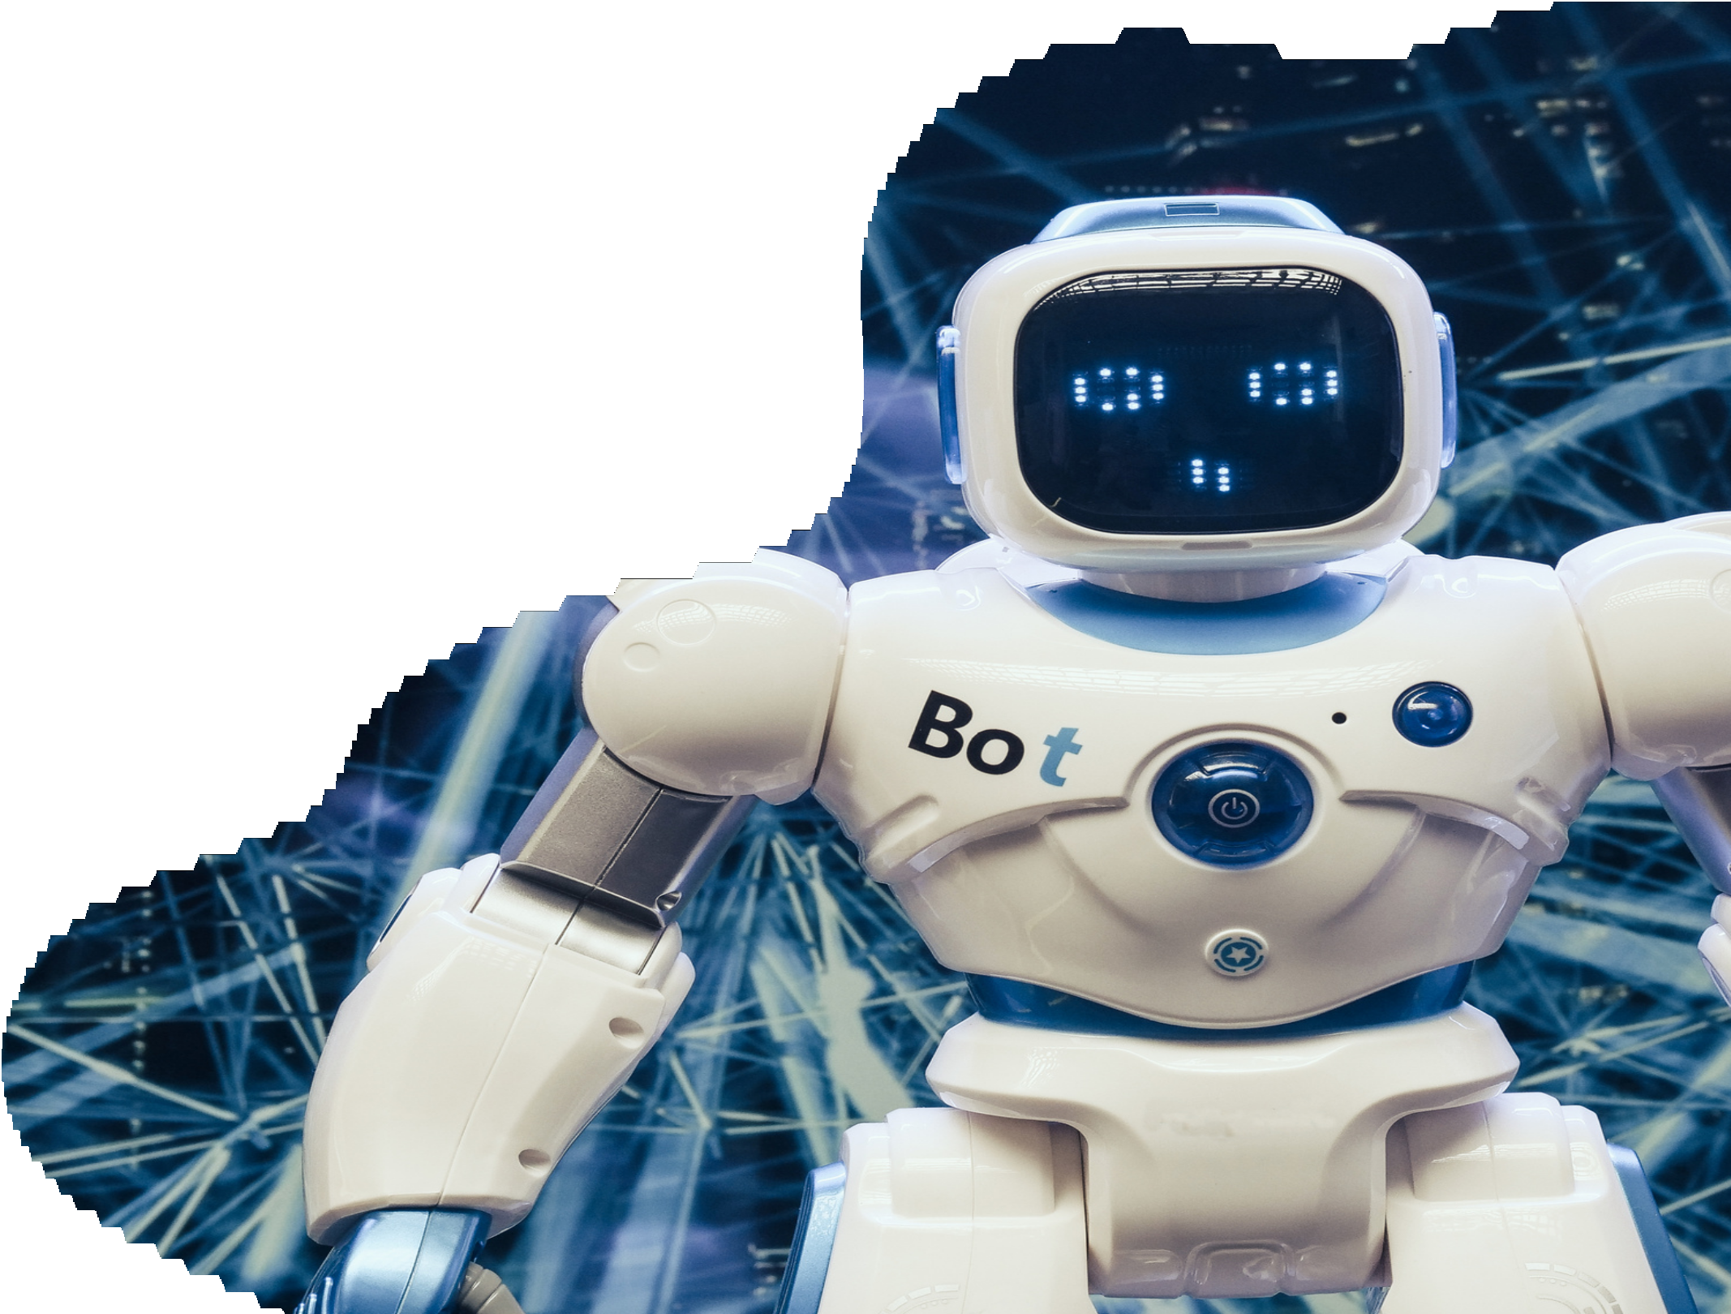








PROJECT
SYNOPSIS On
Chatbot
intelligence by machines

Slide 3











What is Chatbot
A Chatbot is an Artificial Intelligence (AI) software that can simulate a conversation (for chat) with a user in natural language through messaging applications, websites, mobile apps or through the telephone.
Anyone drive information from a Raw data
It saves time and money
providing customer service, presenting product recommendations

Slide 4








Abilities of CHATBOT
01
It can give required information
03
Gives guidance towards admission process
02
Tells about the college like placements, faculty etc.
04
Connect with potential applicants 24/7
We can say that ChatBots attained the vast characteristics of human experts to perform complex tasks in seconds

Slide 5





How do automated chatbots work?
Chatbots work with a knowledge base and your institutional documentation to provide accurate information.
They provide automated responses to prospective student queries and help them carry out basic tasks on the college website.
They can type their questions in their own voice and get an accurate response from the chatbot.
Applicants don’t have to know technical terms, nor do they have to search through multiple links, websites, or documents to get the answers they need.
They provide answers to common questions and guide students through the admission process, day or night, while also capturing the visitor’s contact information.

Slide 6


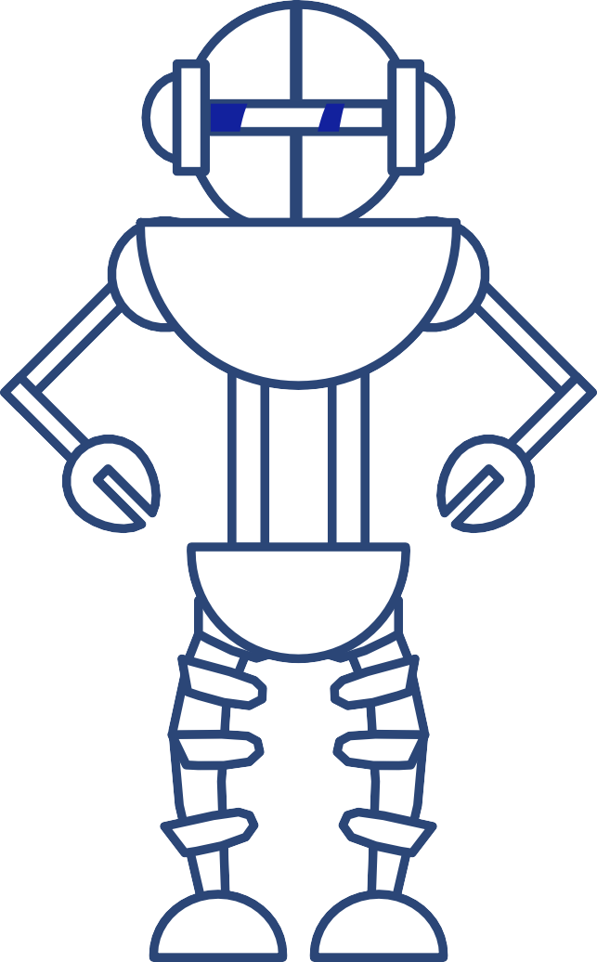

Importance of ChatBot
A great tool for almost any modern company, artificial intelligence technology offers a number of important advantages, including:
Automation Accuracy Enhancement Analysis Instant
01
02
03
04
05

Slide 7
ALGORITHM:

Slide 8
STEP 1: START
STEP 2: Required libraries are imported like re STEP 3: Import Database
STEP 5: Counts how many words are present in each predefined message
STEP 6: Calculates the percent of recognized words in a user message

Slide 9
STEP 7: Checks that the required words are in the string
STEP 8: Must either have the required words, or be a single response
STEP 9 Simplifies response creation / adds it to the dictionary
STEP 10: END

Slide 10
CODE:

Slide 11
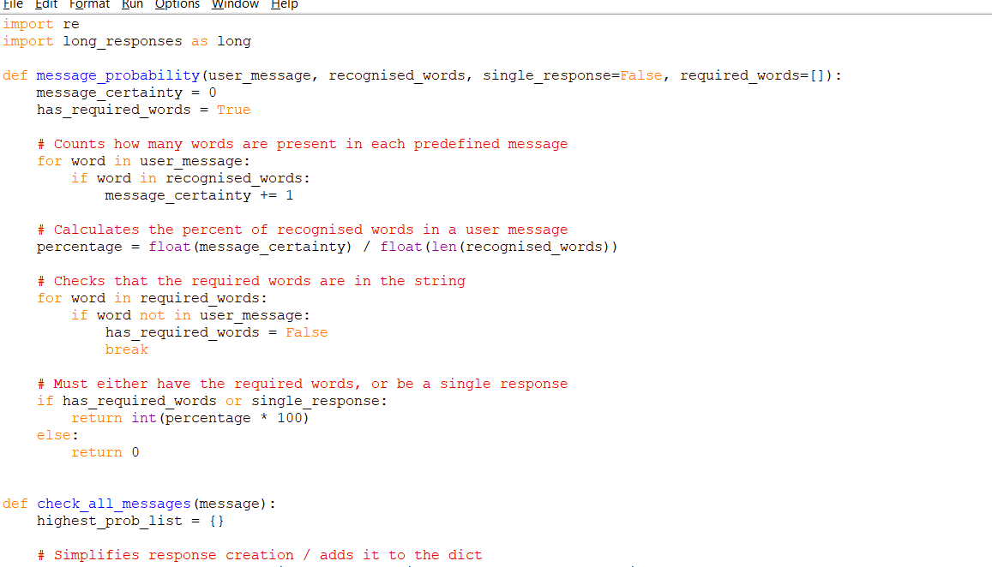




Thank You

Slide 12
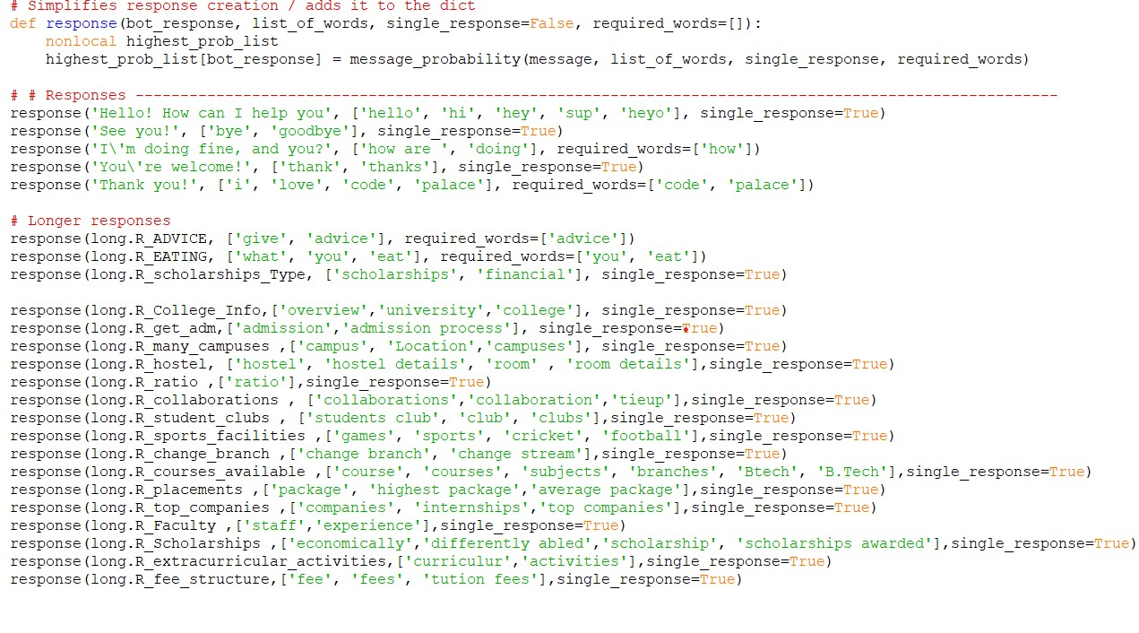

Slide 13
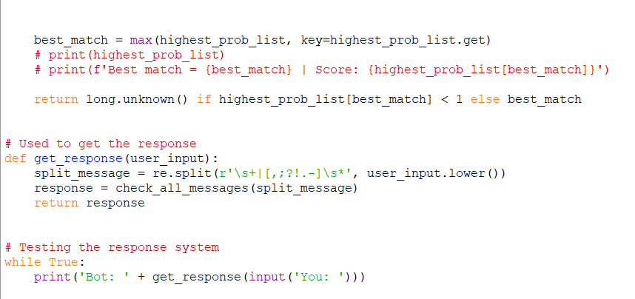

Slide 14
THANK YOU

